Slide 1
Regression Analysis of Financial Stock Returns: An Examination Using Multiple Model Approaches
Akhilesh A S 23BM6JP03
Akshay K 23BM6JP05
Aswin V T 23BM6JP14
Kapil Pushkar 23BM6JP21

Slide 2
Introduction
Purpose of Regression Analysis: Utilizing statistical regression analysis as a fundamental tool in financial markets for investment strategies and decision-making.
Project Focus: Exploring the dynamics of stock prices, particularly aiming to uncover patterns and predict future movements of Amazon Inc.'s stock with higher accuracy.
Primary Regressors: Inclusion of major technology and index stocks such as SPY (S&P 500 ETF), AAPL (Apple Inc.), MSFT (Microsoft Corporation), and GOOGL (Alphabet Inc.) due to their significant market impact and representation of both sector-specific and market-wide trends.
Role of Fama-French Factors: Analyzing risk-related factors through Fama-French models to enhance understanding of fluctuations in Amazon's stock price.
Objective of the Analysis: Applying various regression techniques to gauge how effectively different models capture the returns of these stocks in relation to market movements and other variables.
Contribution to Knowledge: By examining the predictive capabilities of these models, the research aims to deepen both academic and practical insights into asset pricing and investment strategy optimization in volatile financial environments.

Slide 3
About DataSet
Dataset Overview: The dataset comprises two parts:
Stock price Prices of various companies.
Fama_french factor values for the same time period
Source of Data: Stock prices sourced from Yahoo Finance, a well-established platform that provides extensive financial information, including stock quotes and financial reports.
Data Retrieval Tool: Utilizes the Python library yfinance to download historical market data, ensuring a streamlined and efficient data collection process.
Type of Stock Price Used: Adjusted Close Price, which accounts for corporate actions like dividends, stock splits, and new stock offerings, thus offering a truer reflection of the stock's historical value.
Specific Stocks Analyzed: Includes adjusted closing prices for ‘S&P500’, ‘APPLE’, ‘AMAZON’, ‘MICROSOFT’, and ‘GOOGLE’ for each trading day spanning from January 1, 2015, to December 31, 2023.

Slide 4
Fama-French Factor Data
Purpose of Factors: These factors explain stock or portfolio returns based on dimensions of size, value, profitability, and investment patterns.
Construction of Factors:
SMB (Size Factor): excess return of small-cap stocks over big-cap stocks
HML (Value Factor): excess returns of stocks with high Book-to-Market ratios over those with low ratios.
RMW (Profitability Factor): return difference between stocks of companies with high and low profitability.
CMA (Investment Factor): Differentiates between the returns of companies with conservative and aggressive investment strategies.
Calculations:
SMB: Computed as an average of three different SMB scores (based on Book-to-Market, Operating Profitability, and Investment).
HML: Calculated by contrasting the average returns of the top and bottom portfolios sorted by Book-to-Market ratios.
RMW: Derived from comparing returns of the most and least profitable firms.
CMA: Obtained by assessing the return differences between conservative and aggressive investment portfolios.

Slide 5
Preprocessing and Data Cleaning
Data Cleaning Objectives: Ensure the dataset is free from missing or NaN values and prepare it for analysis.
Data Source Integrity: Utilizes reliable financial data sourced from Yahoo Finance, generally clean and accurate.
Handling Non-Trading Days: Excludes weekends and holidays from the dataset as these dates do not have trading data, thus are not present in the DataFrame.
Calculating Returns
Method of Calculation: Computes daily stock returns using the logarithmic return formula to normalize price movements.
Transformations and Assumptions:
Logarithmic Transformation: Applied to stock prices to compute daily returns, supporting the assumptions of linear regression by stabilizing variance.
Handling Initial NaN Value: The first row in the returns DataFrame is NaN because there is no preceding day's price data for the initial date.

Slide 6
Model Fitting Overview
Objective: Understand the relationship between Amazon's (AMZN) returns and other significant stocks or stock market indices and different factors of it, through regression models.
Simple CAPM Model
- Purpose: The CAPM model explains the relationship between systematic risk and expected return of stocks.
- Model: ra - rf = α + βM(MKT - rf)
Where:
ra = Return of the asset (AMZN)
rf = Risk-free return (U.S. 3-month T-bill)
MKT = Market return (S&P 500)
α, βM = Intercept and market sensitivity of the asset

Slide 7
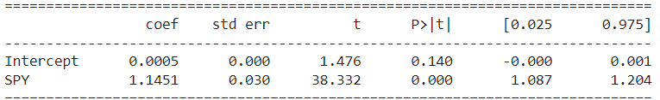
Results:
- Adjusted R-Squared: 0.394
- P value(F-statistic): 4.03 e-248
- Durbin-Watson: 1.961
- P value(Breusch-Pagan test): 0.0535

Slide 8
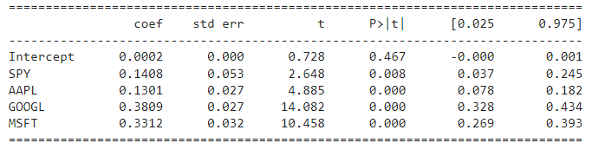
Multiple Linear Regression Models
- Stock Returns Model: This model includes returns from the S&P 500, Apple, Google, and Microsoft to predict Amazon's returns.
- Results:
- Adjusted R-Squared: 0.511
- Prob (F-statistic): 0.00
- Durbin-Watson: 2.002
- P value(Breusch-Pagan test): 2.301e-06

Slide 9
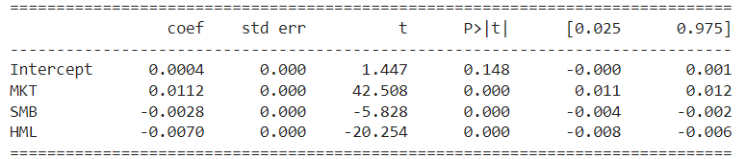
Fama-French 3-Factor Model
- Factors Used: MKT, SMB, HML.
- FF3 mode adds in size and value as risk factors to the model as shown.
- Results:
- Adjusted R-Squared: 0.519
- Prob (F-statistic): 0.00
- Durbin-Watson: 2.006
- P value(Breusch-Pagan test): 0.291

Slide 10
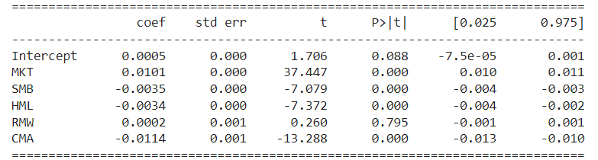
Fama-French 5-Factor Model
- This model added two 'quality' factors, namely profitability and investment factors and is modelled as below:
- Results:
- Adjusted R-Squared: 0.554
- Prob (F-statistic): 0.00
- Durbin-Watson: 2.004
- P value(Breusch-Pagan :0.001277

Slide 11
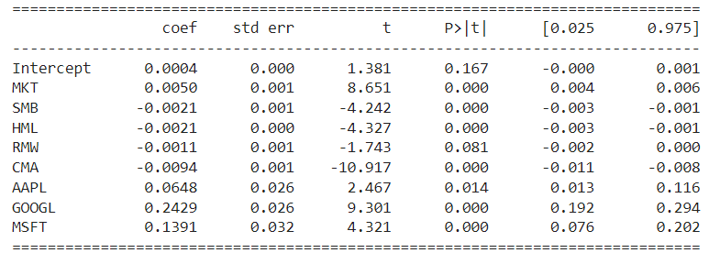
Combined Model
- **Composition**: Incorporates all stock returns (AAPL, GOOGL, MSFT) and Fama-French factors (MKT, SMB, HML, RMW, CMA).
- **Results**:
- Adjusted R-Squared: 0.578
- Prob (F-statistic): 0.00
- Durbin-Watson: 2.008
- P value(Breusch-Pagan : 1.1990e-10

Slide 12
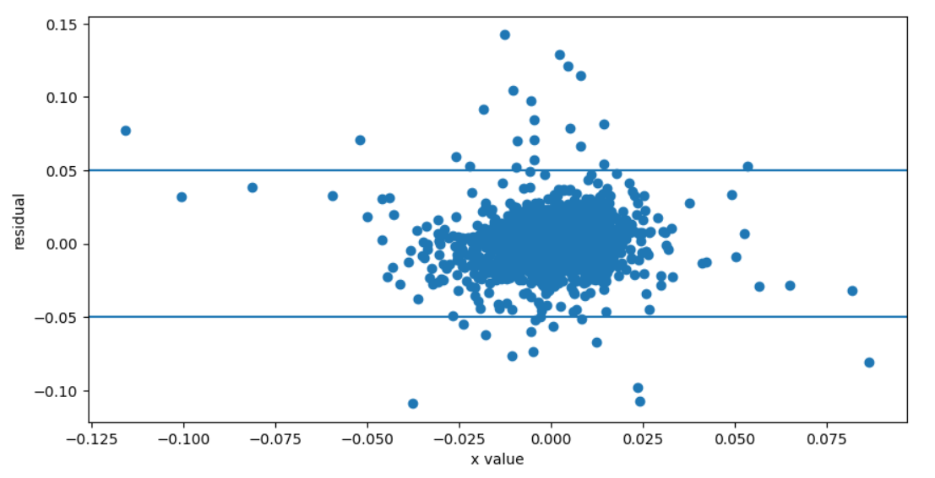
Model Diagnostics
Residual Analysis:
Plots of residuals from each model showed an approximately normal distribution, confirming the validity of the normality assumption in linear regression.
Normal distribution of residuals supports the reliability of inferences drawn from the models.
Homoscedasticity Analysis:
For the CAPM model, scatter plots were used due to the presence of a single regressor. Spread of residuals showed some changes across values of the independent variable, this could also be due to the fact that there are more residuals in the middle than at the extremes..
Horizontal reference lines at 0.05 and -0.05 in the plots helped assess residual dispersion.

Slide 13
Breusch-Pagan Test for Heteroscedasticity:
Null hypothesis: Residuals are homoscedastic (equal variance).
P-values:
Simple CAPM Model: 0.0534 (Homoscedastic)
MLR with Stock Returns as Regressors: 2.3e-06 (Heteroscedastic)
Fama-French 3-Factor Model: 0.291 (Homoscedastic)
Fama-French 5-Factor Model: 0.0012 (Heteroscedastic)
Combined Model: 1.1990e-10 (Heteroscedastic)
Implications of Heteroscedasticity:
In models exhibiting heteroscedasticity, the ordinary least squares (OLS) estimator for the covariance matrix of regression coefficients may be biased.
This bias could affect the accuracy of standard errors and hypothesis tests.

Slide 14
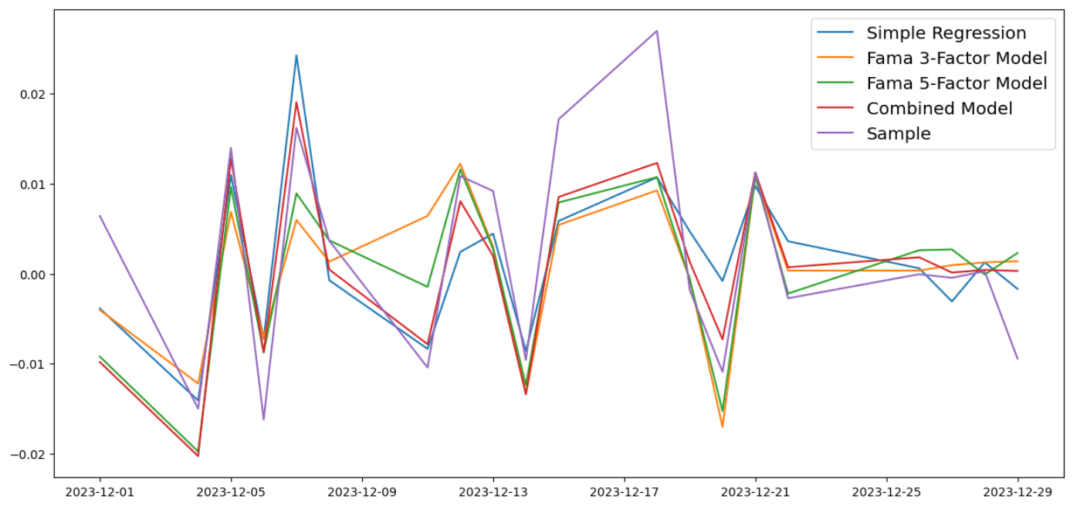

Training Predictions
Visual Analysis: Reviewed the last 20 return points predicted by each model compared to the actual returns.
Purpose: This step ensures that models capture the trend and volatility of the data accurately before testing.
Testing Procedures:
Data Period: Used stock returns and Fama-French factors from January 1, 2024, to the end of February 2024 for testing.
Metrics Used:
Root Mean Square Error (RMSE): Measures the average magnitude of the errors.
Mean Absolute Error (MAE): Measures the average absolute errors, which provides a clearer measure of forecast accuracy.

Slide 15
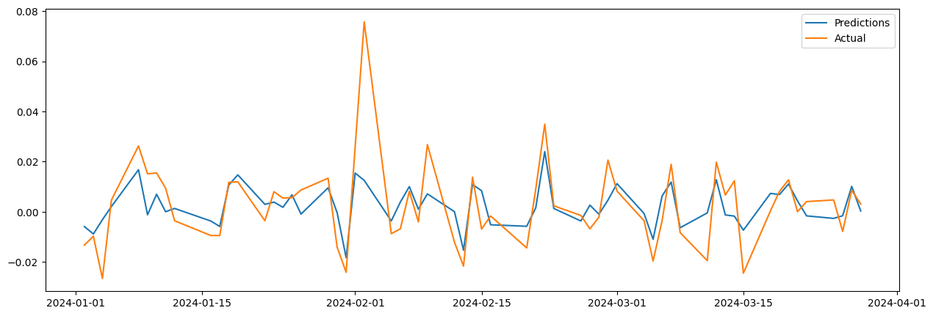
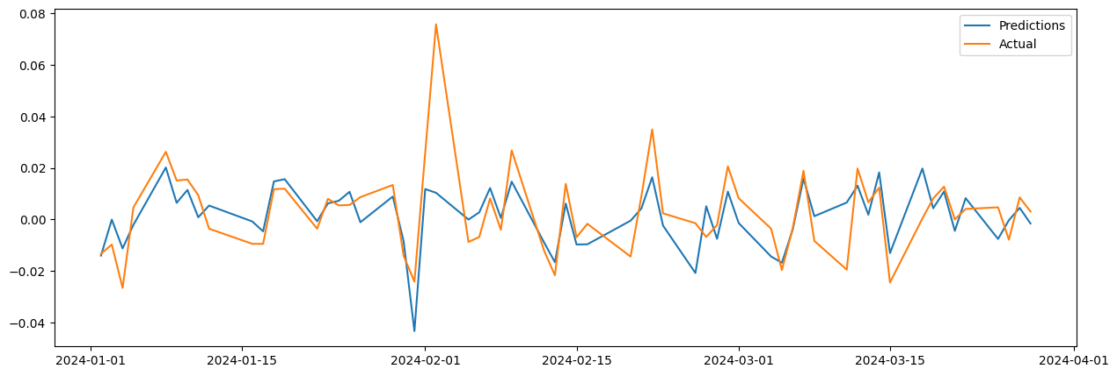
Model Performance Results:
Simple CAPM Model:
RMSE: 0.0119
MAE: 0.0081
Multiple Linear Regression with Stock Returns:
RMSE: 0.0124
MAE: 0.0086

Slide 16
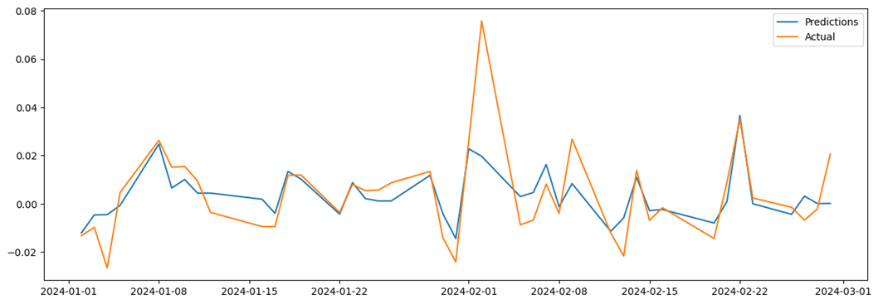
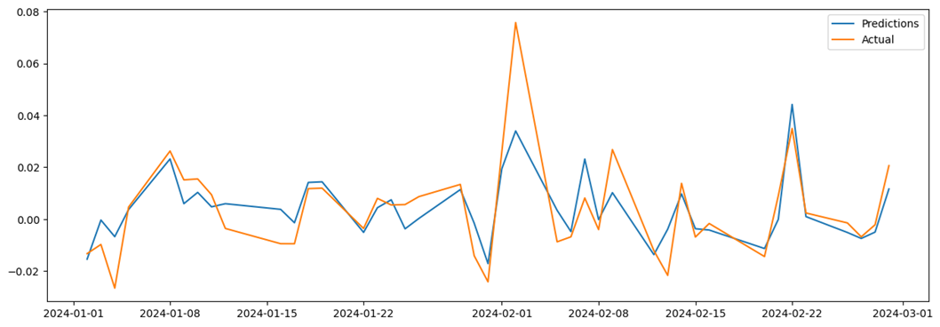
Model Performance Results:
Fama-French 3-Factor Model:
RMSE: 0.012
MAE: 0.0075
Fama-French 5-Factor Model:
RMSE: 0.0104
MAE: 0.0073

Slide 17
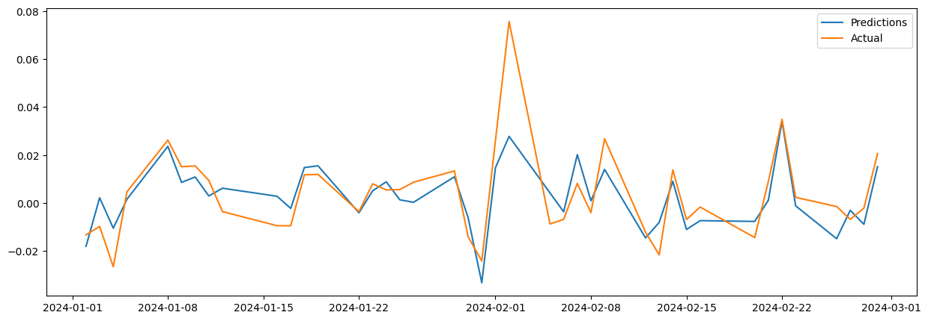
Model Performance Results:
Combined Model with All Stock Returns and Fama-French Factors:
RMSE: 0.0106
MAE: 0.0075

Slide 18

Comprehensive Model Evaluation
Best Model Fit:
The Fama-French 3-factor model, demonstrating homoscedasticity and capturing maximum variance, was identified as the best fit among all tested models.
Durbin-Watson Coefficient:
Values close to 2 across models indicate no significant autocorrelation in residuals.
Durbin-Watson Coefficient:
Values close to 2 across models indicate no significant autocorrelation in residuals.
Best Model Fit:
The Fama-French 3-factor model, demonstrating homoscedasticity and capturing maximum variance, was identified as the best fit among all tested models.
Updated Covariance Matrix Formula:
Uses White’s estimator to adjust for heteroscedasticity, ensuring robust standard errors and valid hypothesis testing.

Slide 19
Thank You

